Slide 1
(Almost) All of Machine Learning
Rayid Ghani
Slides liberally borrowed and customized from lots of excellent online sources

Slide 2
What we’ll cover today
What is Machine Learning
Examples
Process
Evaluation Methodology
Methods
Doing ML with Python and sklearn

Slide 3
After today, you should be able to
Formulate a policy or social science problem as a machine learning problem
Understand, use, and evaluate machine learning methods

Slide 4
Machine Learning
“A computer program is said to learn from experience E with respect to some task T and some performance measure P, if its performance on T, as measured by P, improves with experience E.”

Slide 5
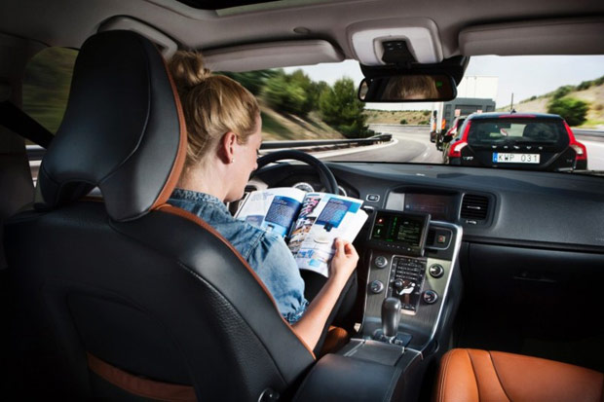
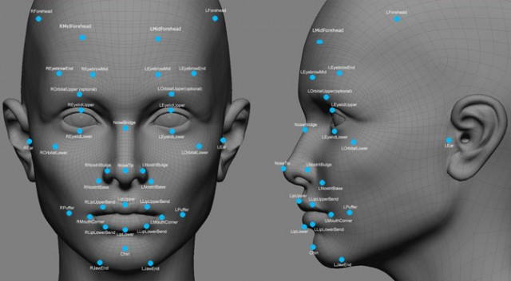



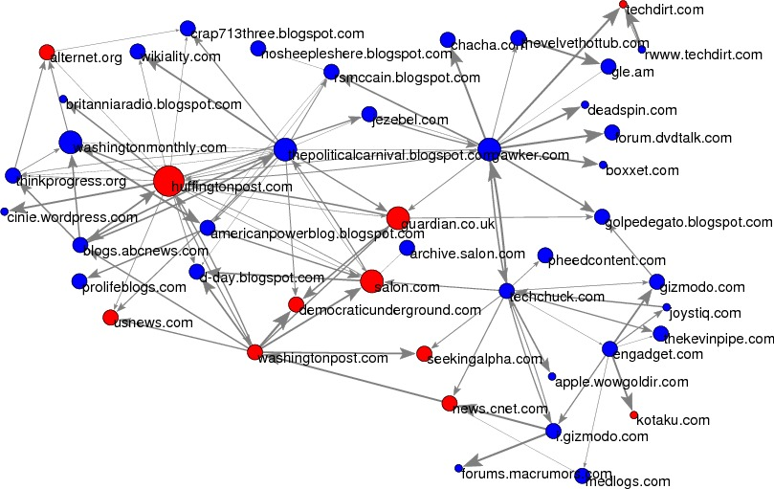
Notes:
Usps
Amazon/netflix - recommender
Advertising
Health
Autonomous cars

Slide 6
Why Machine Learning?
Goal: Adaptive, Scalable systems that are cost effective to build and maintain
Rules-based systems are rigid and expensive
Lots of data is available to “train” the system
People are better at “training” the system compared to “building” the system

Slide 7
Process
Understand “Business” problem
Map to Machine Learning problem
Get (and integrate) the data
Explore and Process the data
Create “Features”
Select which methods to test
Evaluate methods
Deploy, Maintain, Update

Slide 8
Types of ML tasks for Policy Problems
Description (Understand the past)
Detection (Anomalies, Events, Patterns)
Prediction (Predict the Future)
Behavior Change (Causal Inference)

Slide 9
Types of Learning
Unsupervised
Clustering
PCA
…
Supervised
Classification
Regression
…

Slide 10
Unsupervised Learning
No outcome or dependent variable is present
Goal is exploration, understanding historical data, finding patterns and/or groups in the data
Examples
Clustering (cluster analysis)
Principal Components Analysis
Association Rules (beer and diapers)

Slide 11
Clustering
A good clustering method will produce clusters with
High intra-cluster similarity
Low inter-cluster similarity
K-Means is the simplest and the most common algorithm

Slide 12
K-means example, step 1
k₁
Y
Pick 3
initial
cluster
centers
(randomly)
k₂
k₃
X

Slide 13
K-means example, step 2
k₁
Y
k₂
Assign
each point
to the closest
cluster
center
k₃
X

Slide 14
K-means example, step 3
k₁
k₁
Y
Move
each cluster center
to the mean
of each cluster
k₂
k₃
k₂
k₃
X

Slide 15
K-means example, step 4
Reassign
points
closest to a different new cluster center
k₁
Y
k₃
k₂
X

Slide 16
K-means example, step 4 …
k₁
Y
Reassigned Data points
k₃
k₂
X

Slide 17
K-means example, step 4b
k₁
Y
re-compute cluster means
k₃
k₂
X

Slide 18
K-means example, step 5
k₁
Y
k₂
move cluster centers to cluster means
k₃
X

Slide 19
K-means algorithm
Given k, the k-means algorithm works as follows:
Randomly choose k data points (seeds) to be the initial centroids, cluster centers
Assign each data point to the closest centroid
Re-compute the centroids using the current cluster memberships.
If a convergence criterion is not met, go to 2).

Slide 20
More Clustering Methods
K-means
Iteratively re-assign points to the nearest cluster center
Agglomerative clustering
Start with each point as its own cluster and iteratively merge the closest clusters
Mean-shift clustering
Estimate modes of pdf
Spectral clustering
Split the nodes in a graph based on assigned links with similarity weights
As we go down this chart, the clustering strategies have more tendency to transitively group points even if they are not nearby in feature space

Slide 21
Evaluating Clustering Methods
Objective Evaluation
Task-Specific Evaluation
Same data can be clustered in different ways in different number of clusters
Can be used to interactively explore data

Slide 22
Supervised learning framework
y
= f( )
X
output
“Learned”
function
Features/Predictors
future/generalization
Training or Learning: Find an f that minimizes error in recovering y
Slide credit: L. Lazebnik

Slide 23
Supervised learning framework
y
= f( )
X
output
“Learned”
function
Features/Predictors
Training: Given a training set of labeled examples {(x₁,y₁), …, (x_{N},y_{N})}, estimate the prediction function f that minimizes future generalization (out of sample) error
Scoring/Testing: apply f to a new example x and output the predicted value y = f(x)
Slide credit: L. Lazebnik

Slide 24
Steps
Data Preparation
Build Model
Validate Model
Deploy Model
Features

Slide 25
How to solve a prediction problem
Define and Create label (outcome variable)
Define and Create Features (predictors)
Create Training and Validation Sets
Train model(s) on Training Set
Validate model(s) on Validation Set

Slide 26
Validation
Data
person 1
person 2
person 3
person 4

Slide 27
In-sample
Data
Train
Test

Slide 28
Out-of-Sample
Data
Train
Test

Slide 29
Evaluation - Methodology
In-sample
Out of sample
Splits to deal with variance
Cross Validation
Leave one out (LOO)
K fold
Temporal
Baseline?

Slide 30
Modeling & Validation
Training (Building)
Training Labels
Features
Training
Learned model
Training Data
Testing (Validating)
Features
Learned model
Prediction
Test Data

Slide 31
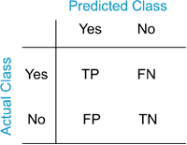
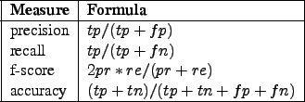
Evaluation - Metrics
Accuracy
Precision
Recall
ROC
…
Threshold?

Slide 32
(Some) Popular/Common Methods
Regression (not going to cover)
Nearest neighbor
Decision Trees
Bayes Classifier (not going to cover)
Support Vector Machines
Neural Networks (not going to cover)
Ensembles
Bagging
Boosting
Random Forests

Slide 33
Classifiers: Nearest neighbor
Test example
Training examples from class 2
Training examples from class 1
f(x) = label of the training example nearest to x
All we need is a distance function for our inputs
No training required!
Slide credit: L. Lazebnik

Slide 34
K-nearest neighbor
x
x
x
o
x
x
x
+
o
o
x
x
o
o
+
o
o
x2
x1

Slide 35
1-nearest neighbor
x
x
x
o
x
x
x
+
o
o
x
x
o
o
+
o
o
x2
x1

Slide 36
3-nearest neighbor
x
x
x
o
x
x
x
+
o
o
x
x
o
o
+
o
o
x2
x1

Slide 37
5-nearest neighbor
x
x
x
o
x
x
x
+
o
o
x
x
o
o
+
o
o
x2
x1

Slide 38
Using K-NN
Simple
“Cheap” to train
With infinite examples, 1-NN provably has error that is at most twice Bayes optimal error

Slide 39
Classifiers: Linear
Find a linear function to separate the classes:
f(x) = sgn(w ⋅ x + b)
Slide credit: L. Lazebnik

Slide 40
Naïve Bayes
y
x₁
x₂
x₃

Slide 41
Using Naïve Bayes
Simple thing to try for categorical data
Very fast to train/test

Slide 42
Classifiers: Logistic Regression
Maximize likelihood of label given data, assuming a log-linear model
x
x
x
x
x
x
male
o
x
x
o
o
Height
o
female
o
x2
x1
Pitch of voice

Slide 43
Using Logistic Regression
Quick, simple classifier (try it first)
Outputs a probabilistic label confidence
Use L2 or L1 regularization
L1 does feature selection and is robust to irrelevant features but slower to train

Slide 44
Classifiers: Linear SVM
x
x
x
x
x
x
o
x
x
o
o
o
o
x2
x1
Find a linear function to separate the classes:
f(x) = sgn(w ⋅ x + b)

Slide 45
Classifiers: Linear SVM
x
x
x
x
x
x
o
x
x
o
o
o
o
x2
x1
Find a linear function to separate the classes:
f(x) = sgn(w ⋅ x + b)
Notes:
Maximizes a margin

Slide 46
Classifiers: Linear SVM
x
x
x
o
x
x
x
o
x
x
o
o
o
o
x2
x1
Find a linear function to separate the classes:
f(x) = sgn(w ⋅ x + b)

Slide 47
Nonlinear SVMs
Datasets that are linearly separable work out great:
But what if the dataset is just too hard?
We can map it to a higher-dimensional space:
0
x
0
x
x²
0
x
Slide credit: Andrew Moore

Slide 48
Nonlinear SVMs
General idea: the original input space can always be mapped to some higher-dimensional feature space where the training set is separable:
Φ: x → φ(x)

Slide 49
Nonlinear SVMs
The kernel trick: instead of explicitly computing the lifting transformation φ(x), define a kernel function K such that K(x_{i} , x_{j}) = φ(x_{i} ) · φ(x_{j})
(to be valid, the kernel function must satisfy Mercer’s condition)
This gives a nonlinear decision boundary in the original feature space:
C. Burges, A Tutorial on Support Vector Machines for Pattern Recognition, Data Mining and Knowledge Discovery, 1998

Slide 50
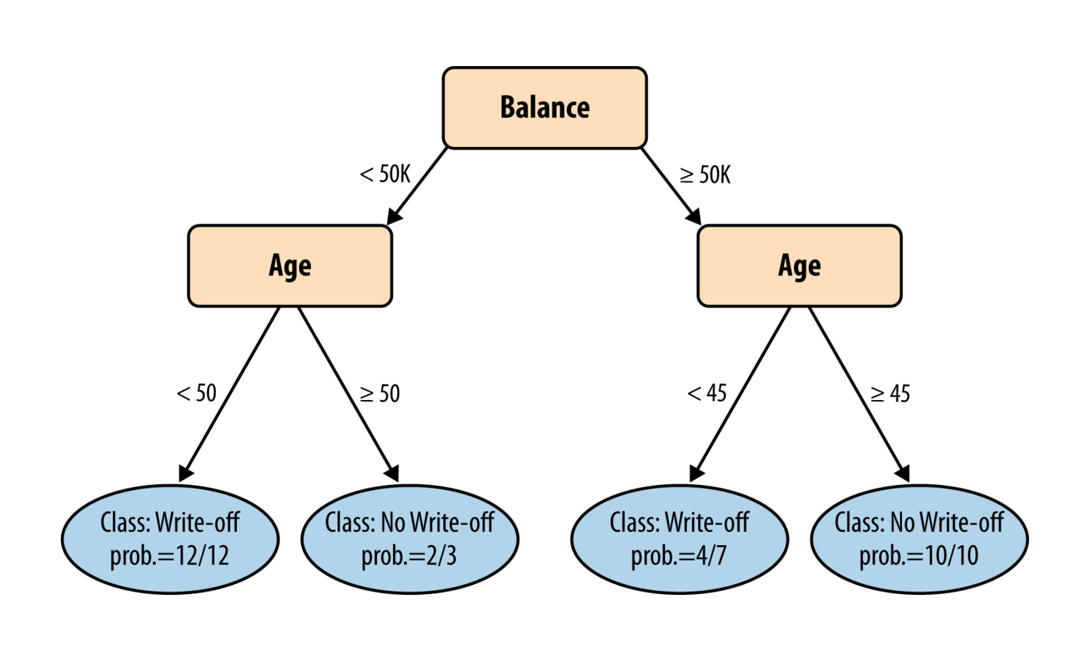
Classifiers: Decision Trees

Slide 51
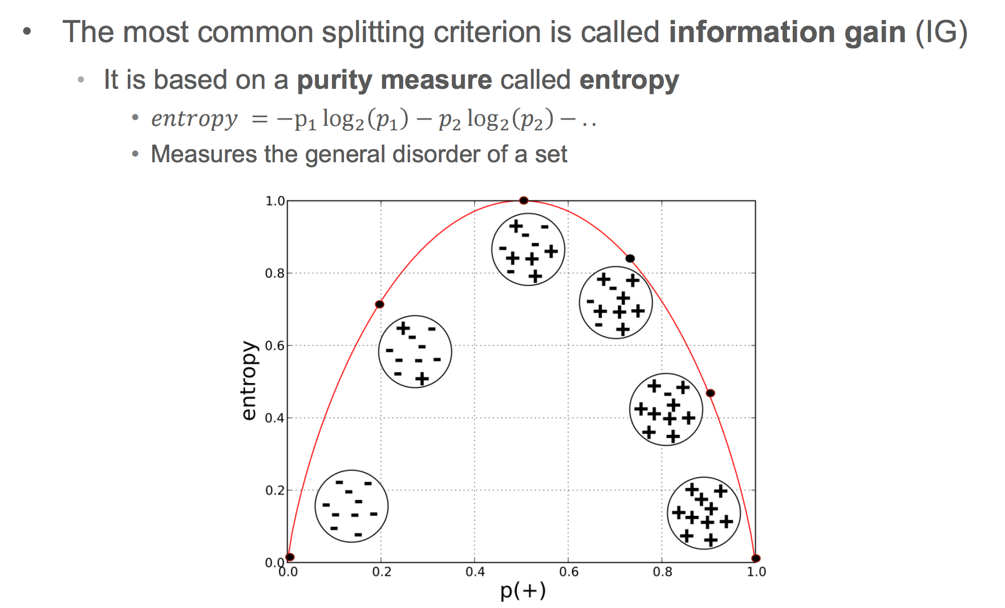
Information Gain

Slide 52
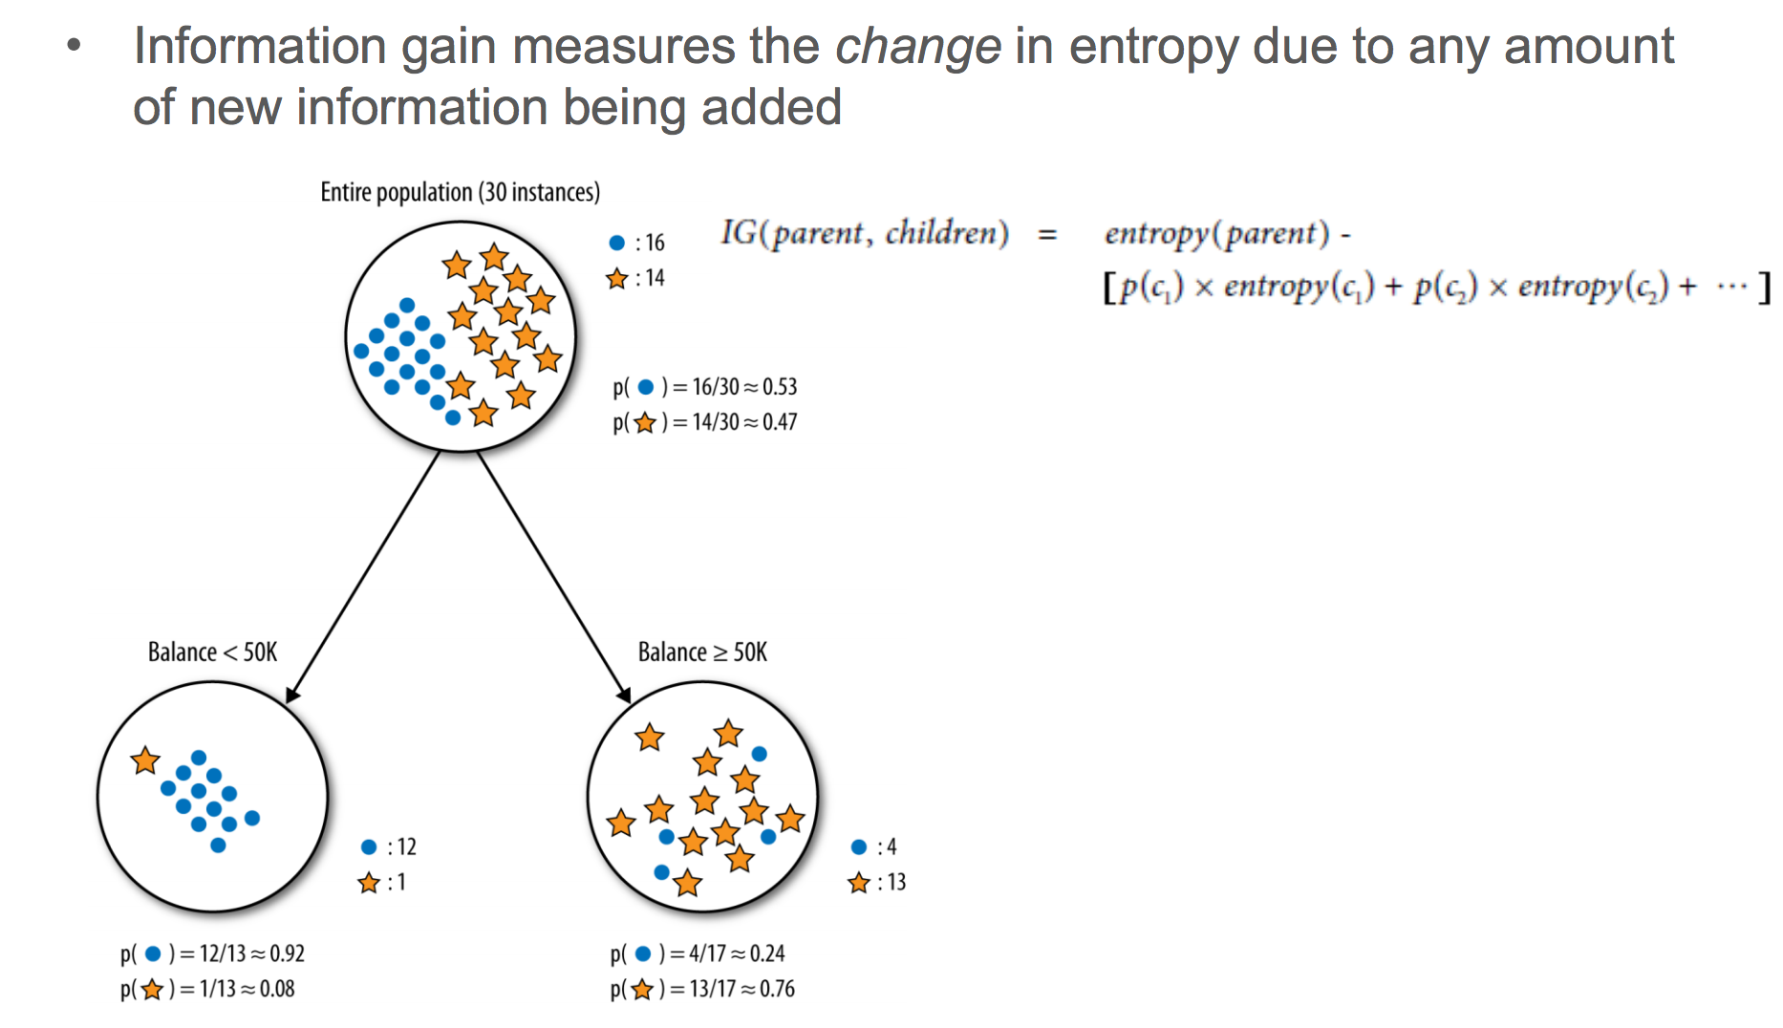

Slide 53
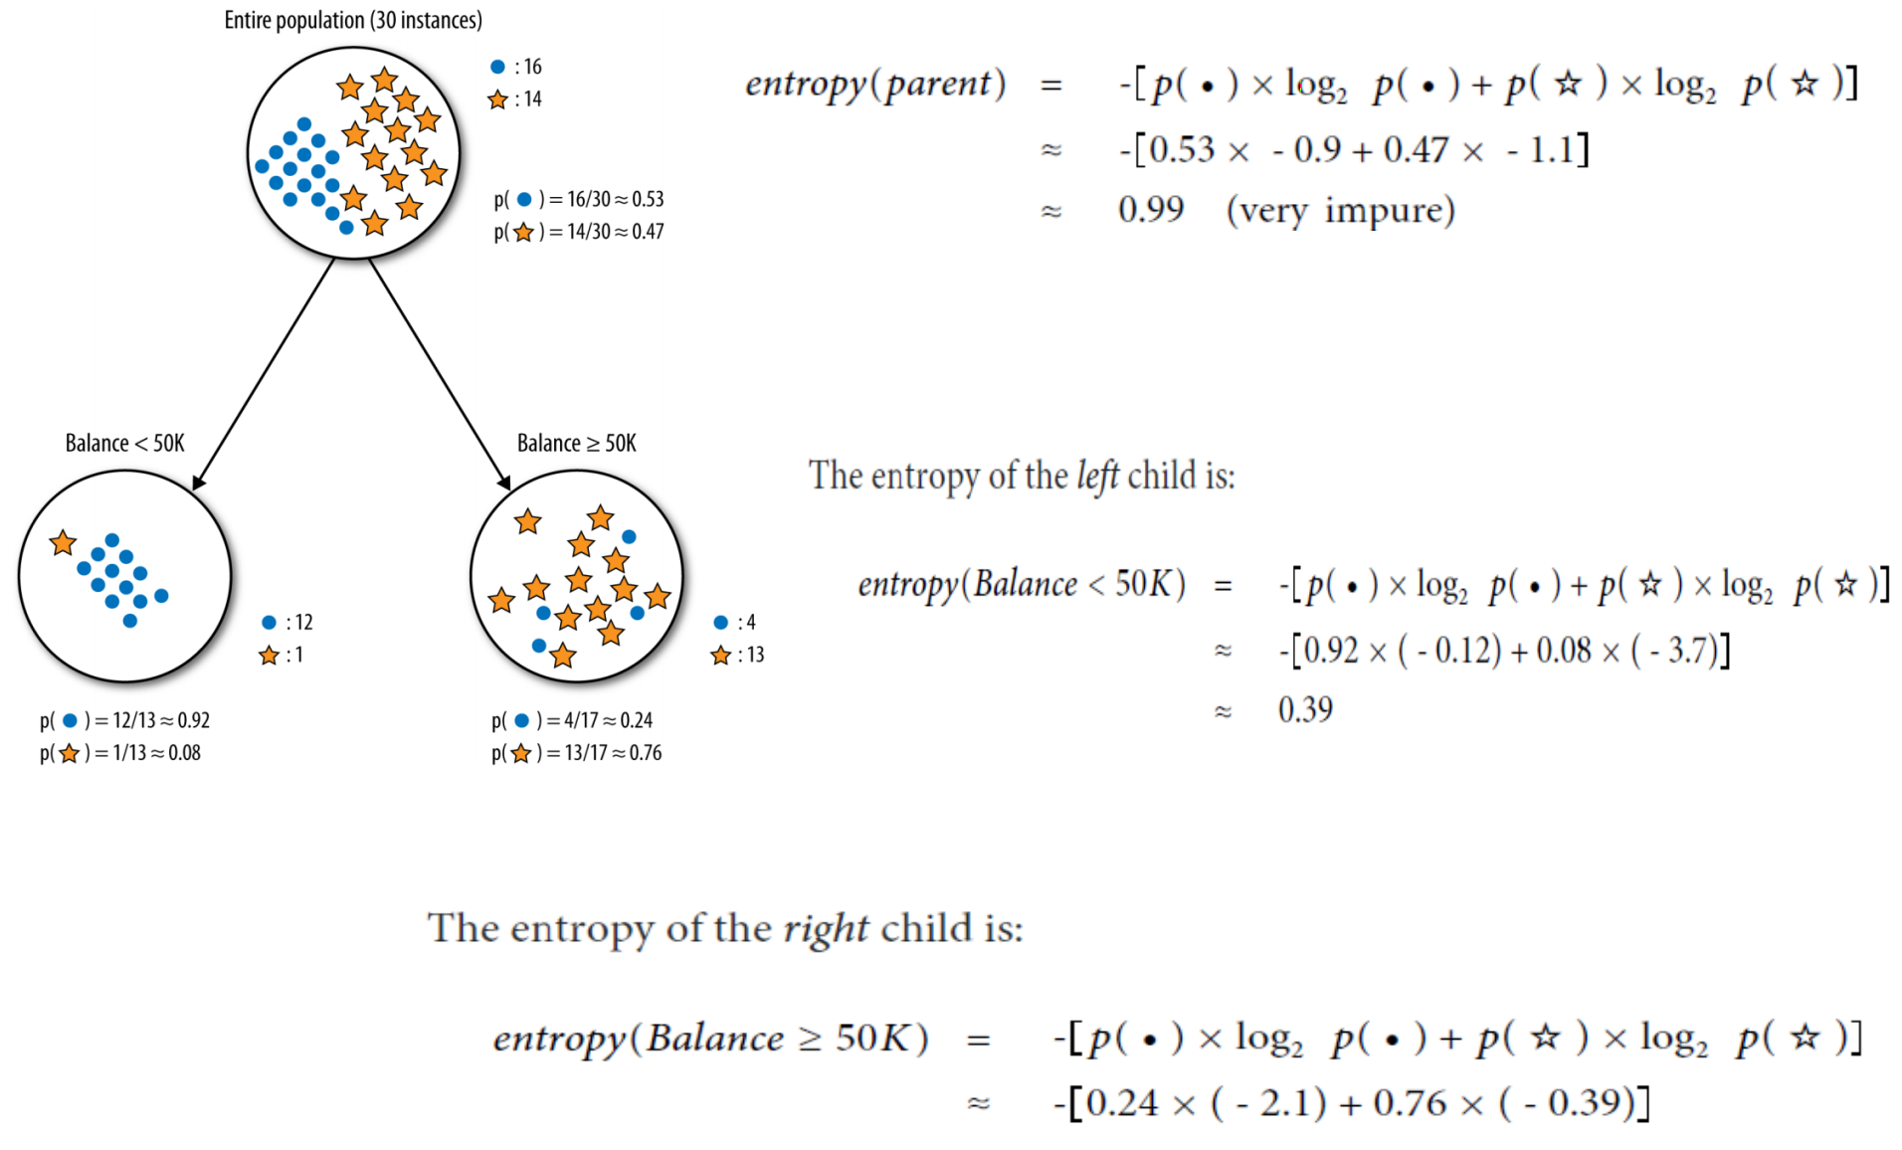

Slide 54
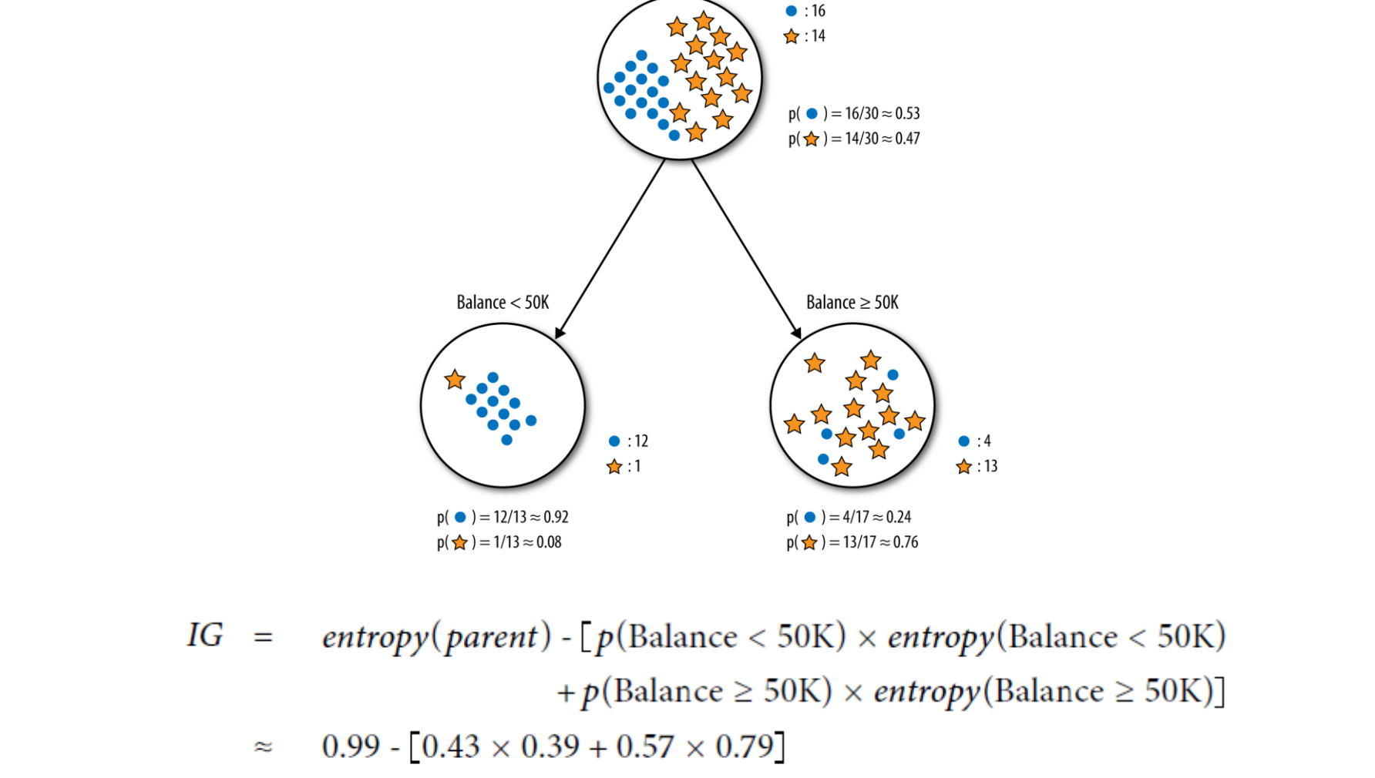

Slide 55
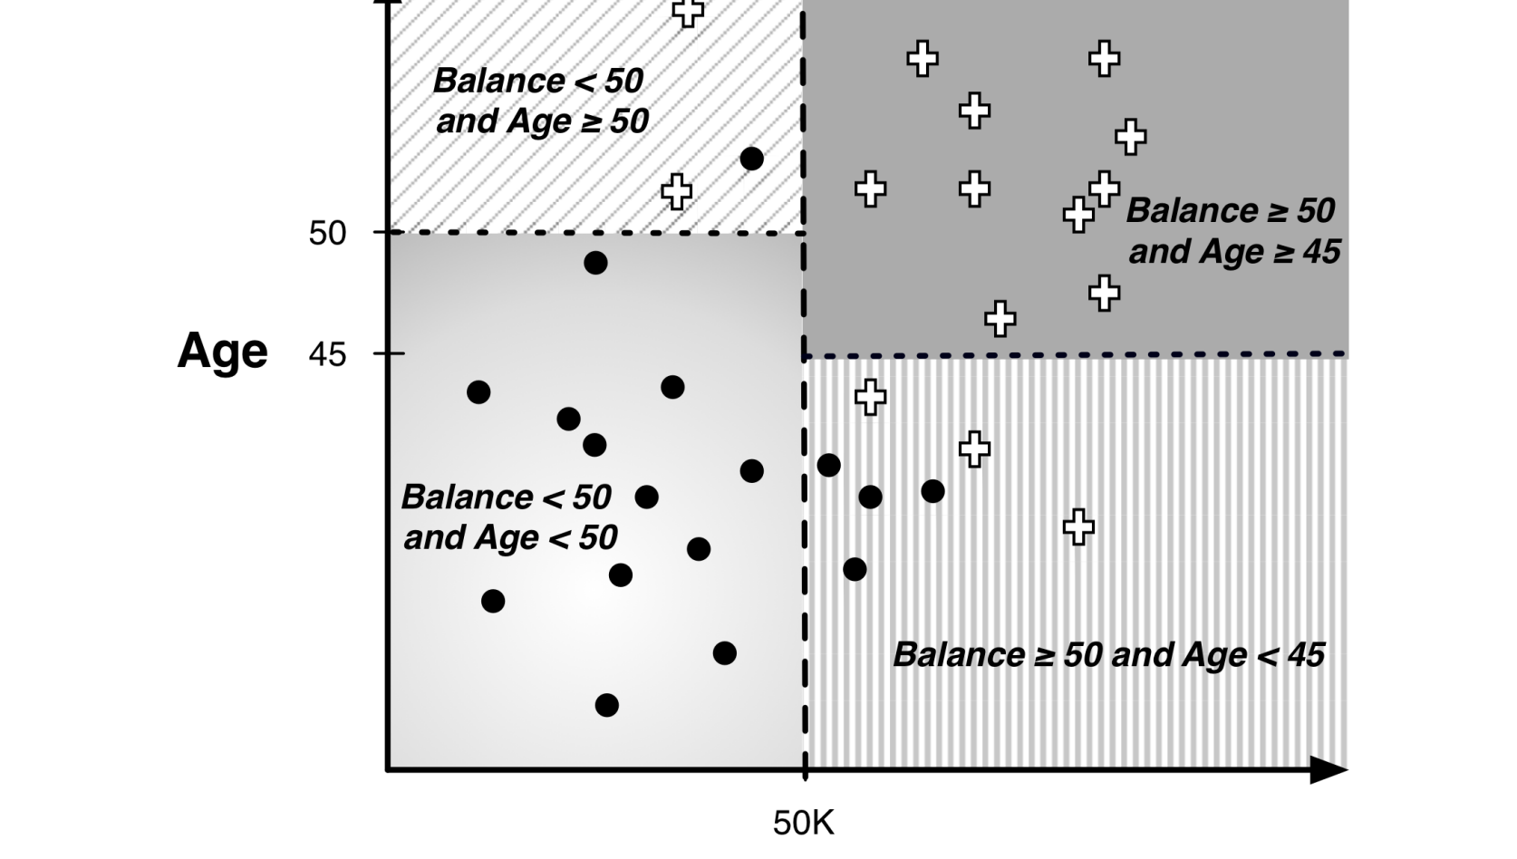

Slide 56
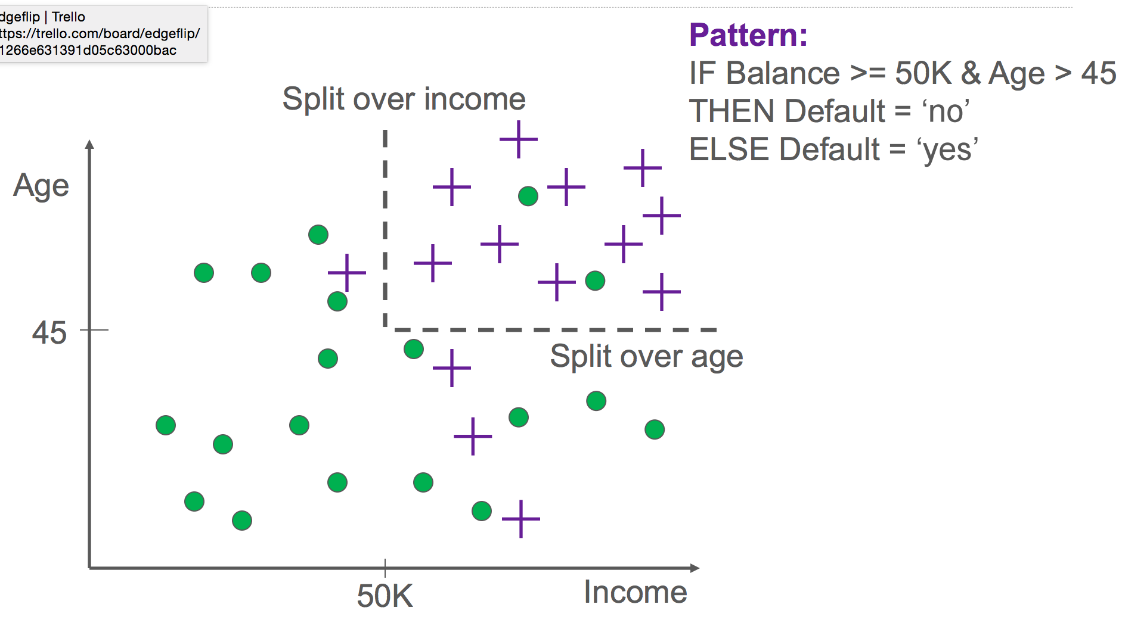

Slide 57
Ensemble Learning
Different methods
Algorithms with different choice for parameters
Data set with different features (e.g. random subspace)
Data set = different subsets (e.g. bagging, boosting)

Slide 58
Ensemble Methods
Bagging (Bootstrap Aggregation)
Boosting
Random Forests
Stacking

Slide 59
Ensemble Methods: Bagging
Create ensembles by repeatedly randomly resampling the training data (Brieman, 1996).
Given a training set of size n, create m samples of size n by drawing n examples from the original data, with replacement.
Each bootstrap sample will on average contain 63.2% of the unique training examples, the rest are replicates.
Combine the m resulting models using simple majority vote.

Slide 60
Ensemble Methods: Bagging
For i = 1 .. M
Draw samples with replacement
Learn classifier C_{i}
Final classifier is a vote of C₁ .. C_{M}
Increases classifier stability/reduces variance
figure from Friedman et al. 2000

Slide 61
Boosting
Examples are given weights.
At each iteration, a new hypothesis is learned and the examples are reweighted to focus the system on examples that the most recently learned classifier got wrong.

Slide 62
Boosting
General Loop:
Set all examples to have equal uniform weights.
For t from 1 to T do:
Learn a classifier, C_{t}, from the weighted examples
Increase the weights of examples C_{t} classifies incorrectly
Base (weak) learner must focus on correctly classifying the most highly weighted examples while strongly avoiding over-fitting.
During testing, each of the T hypotheses get a weighted vote proportional to their accuracy on the training data.

Slide 63
Ensemble Methods: Boosting
Improves classification accuracy
Can be used with many different types of classifiers
Not prone to overfitting
figure from Friedman et al. 2000

Slide 64
Random Forests
Motivation: reduce error correlation between classifiers
Main idea: build a larger number of un-pruned decision trees
Key: using a random selection of features to split on at each node

Slide 65
How Random Forests Work
Each tree is grown on a bootstrap sample of the training set of N cases.
A number m is specified much smaller than the total number of variables M (e.g. m = sqrt(M)).
At each node, m variables are selected at random out of the M.
The split used is the best split on these m variables.
Final classification is done by majority vote across trees.
Source: Brieman and Cutler
65

Slide 66
Advantages of random forest
Error rates compare favorably to Adaboost
More robust with respect to noise.
More efficient on large data
Provides an estimation of the importance of features in determining classification
More info at: http://stat-www.berkeley.edu/users/breiman/RandomForests/cc_home.htm

Slide 67
Factors to consider
Complexity
Overfitting
Robustness
Interpretability
Training Time
Test Time

Slide 68
What to remember about classifiers
Better to have smart features and simple classifiers than simple features and smart classifiers
Need more training data with increasingly powerful classifiers (bias-variance tradeoff)
Slide credit: D. Hoiem

Slide 69
Other tools
Free
Knime
Rapidminer
Weka (mostly research)
Commercial
Sas enterprise miner
Ibm/spss
Kxen
Skytree
megaputer

Slide 70
Advanced Topics
Semi-supervised learning
Active learning
Reinforcement learning
Streaming data

Slide 71
Reference Books & Articles
Machine Learning by Peter Flach
Good introduction to algorithms/models/methods
Data Science for Business by Provost and Fawcett
Good introduction to the ML process
Big Data: New Tricks for Econometrics by Hal Varian
Tom
Tibshirani

Slide 72
Online Resources
Introduction to Statistical Learning http://www-bcf.usc.edu/~gareth/ISL/
Videos: https://www.youtube.com/user/dataschool/playlists?shelf_id=4&sort=dd&view=50
Mining Massive Datasets http://www.mmds.org/

Slide 73
Contact Information
Rayid Ghani
rayid@uchicago.edu

Slide 74
Lectures
Course Overview and Introduction: Goals, Expectations, Structure
Case Studies: Machine Learning used in Public Policy problems
Machine Learning Process and Pipeline Overview
Project Proposal Presentations
Machine Learning Methods: Unsupervised Learning
Machine Learning Methods: Supervised Learning I
Machine Learning Methods: Supervised Learning II
Machine Learning Methods: Supervised Learning III
Feature Development/Engineering
Evaluation Methodology I – offline evaluation
Evaluation Methodology II - experiments
Mapping Policy Problems to Machine Learning Problems
Tools Overview
Putting it all together: Case Study I
Text Analysis
Network Analysis
Putting it all together: Case Study II
Advanced Topics: Reinforcement Learning, …
Ethics, Privacy, Transparency
Recap and Class Discussion

Slide 75
Machine Learning Benefits
The only way to solve problems
Magic
Data-Agnostic
Notes:
Needs to be combined with other methods
Features are important. The expert still needs to do work in defining the problem, generating features, selecting models, evaluation criteria
Without good data, models are bad. Bias, size, etc.

Slide 76
Machine Learning Benefits
The only way to solve problems
Magic
Data-Agnostic
Notes:
Needs to be combined with other methods
Features are important. The expert still needs to do work in defining the problem, generating features, selecting models, evaluation criteria
Without good data, models are bad. Bias, size, etc.

Slide 77
Types of ML tasks for Policy Problems
Description (Understand the past)
Prediction (Predict the Future)
Detection (Anomalies, Events, Patterns)
Behavior Change (Causal Inference)

